Slide 1
Evaluating Historical Returns: A Comparative Study of Technology Stocks, Nasdaq, and Treasury Bonds
Noah Woltman
Leomar Crowal
Maher Mubarak
Bhagi Laksumanage
Sheralyn Saunders

Slide 2
During this presentation, we will be discussing the following:
Evaluating four investment options- Tesla, Nvidia, Nasdaq, 5 yr. treasury bonds
Return on these investments
Correlation between investment options
Exploring the variance of discussed investment options

Slide 3
Cross Comparison Theory
Review two tech investment options, Nvidia & Tesla, alongside the index fund, Nasdaq, and the 5-year treasury yield to analyze potential market trends and assess risk.
Created line charts and calculated variances to analyze and identify signals for investment data that can guide further analysis and research.
Potential use case: Structuring portfolios to diversify investment holdings, a reference point for investment research and educational purposes.

Slide 4
Cross Comparison Graph
We are comparing the performance of four investment opportunities over a 10-year period:
1) Nvidia (NVDA): Nvidia is a semiconductor and artificial intelligence company that has recently become one of the three largest companies on Earth, alongside Apple and Microsoft.
2) Tesla (TSLA): Tesla is an automotive and technology company.
3) NASDAQ: NASDAQ is an index composed of many technology-related stocks, including Nvidia and Tesla.
4) 5-year Treasury Bond yield: The 5-year Treasury Bond yield has significant implications for the stock market.

Slide 5
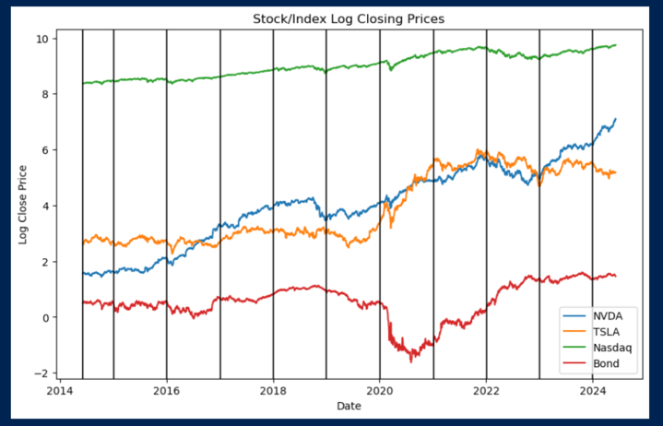
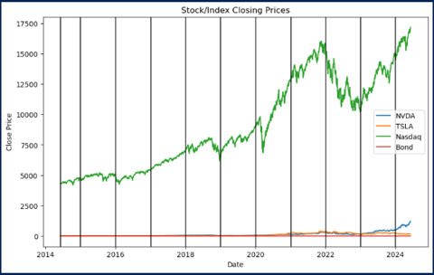
Cross comparison Graphs

Slide 6
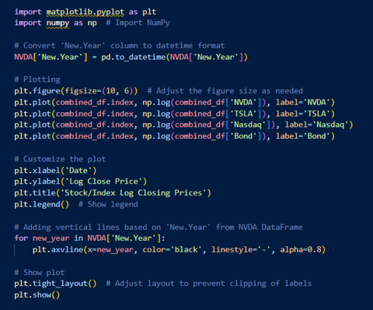
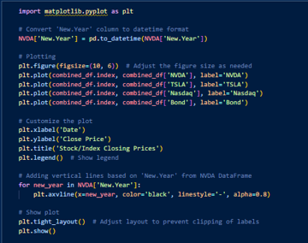
Cross Comparison Code

Slide 7
Variance
The variance is the expectation of the squared deviation of a random variable from its mean, and it informally measures how far a set of (random) numbers are spread out from their mean.
The utility of our variance data point is limited since each investment, to a large extent (but the 5-Year T-Bond less so), exhibits persistent positive drift.

Slide 8
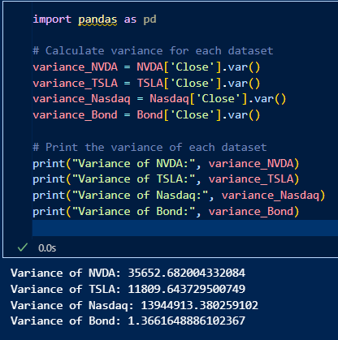
Variance

Slide 9
Cross Comparison Graph & Variance
Our analysis shows the potential impact of tech stocks Nvidia and Tesla on the performance of the Nasdaq index fund over time.
We have also identified signals of possible correlations between the 5-Year T-Bond and the tech investment options.
Further analysis is required to evaluate these correlations and the market impact on their performance.
Variance results help us understand an investment option growth and loss risk.
Tech options have a positive trend with higher growth and loss risk/opportunity, while the 5-Year T-Bond is low-risk and more secure.

Slide 10
Investment Performance
Individual graphs were made as each investment was broken down. The mean value was marked with a horizontal line while the maximum value was marked with a vertical line. The Variance was recalculated in a slightly different way to assist with calculating and three new stats.
The Regression Slope: Shows the average gain in closing prices per unit of time.
The Correlation Coefficient: This measures how well past prices predicts future prices which is also known as autocorrelation. The Nasdaq has the highest, while the 5 Yr. Treasury Bond has the lowest autocorrelation.
The Variance of Squared Residuals: This measures how much each datapoint deviates from the regression line, indicating risk around the trend.

Slide 11
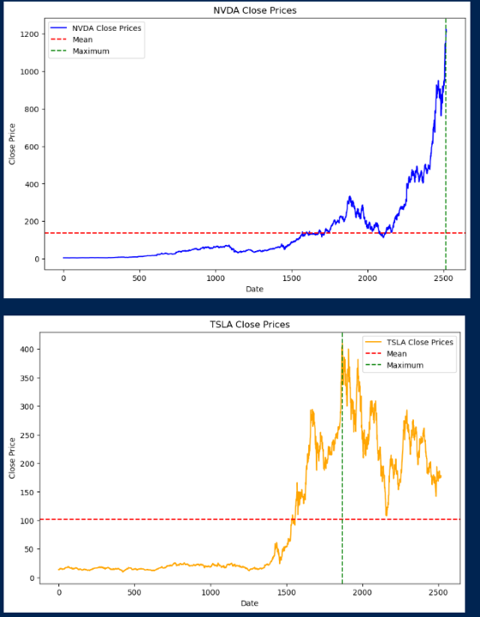
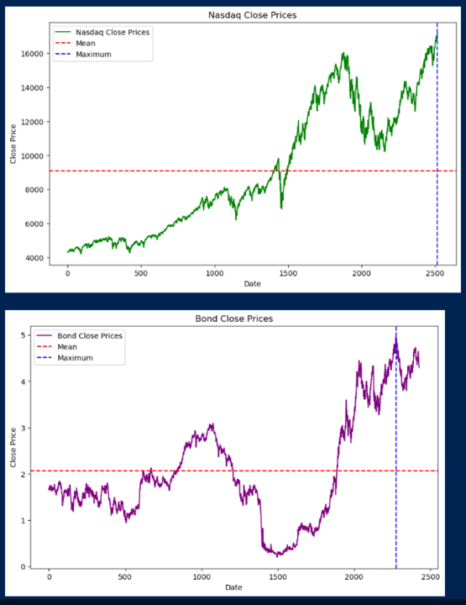
Investment Performance

Slide 12
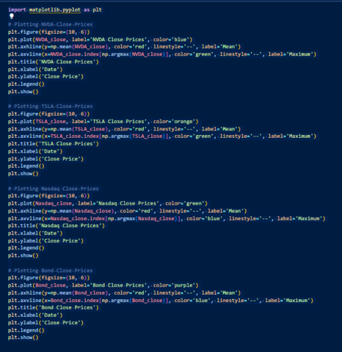
Investment Performance Code

Slide 13
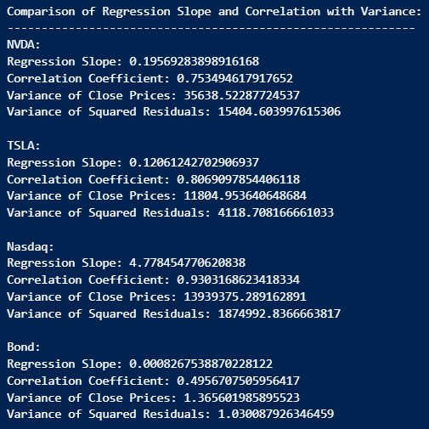

Slide 14
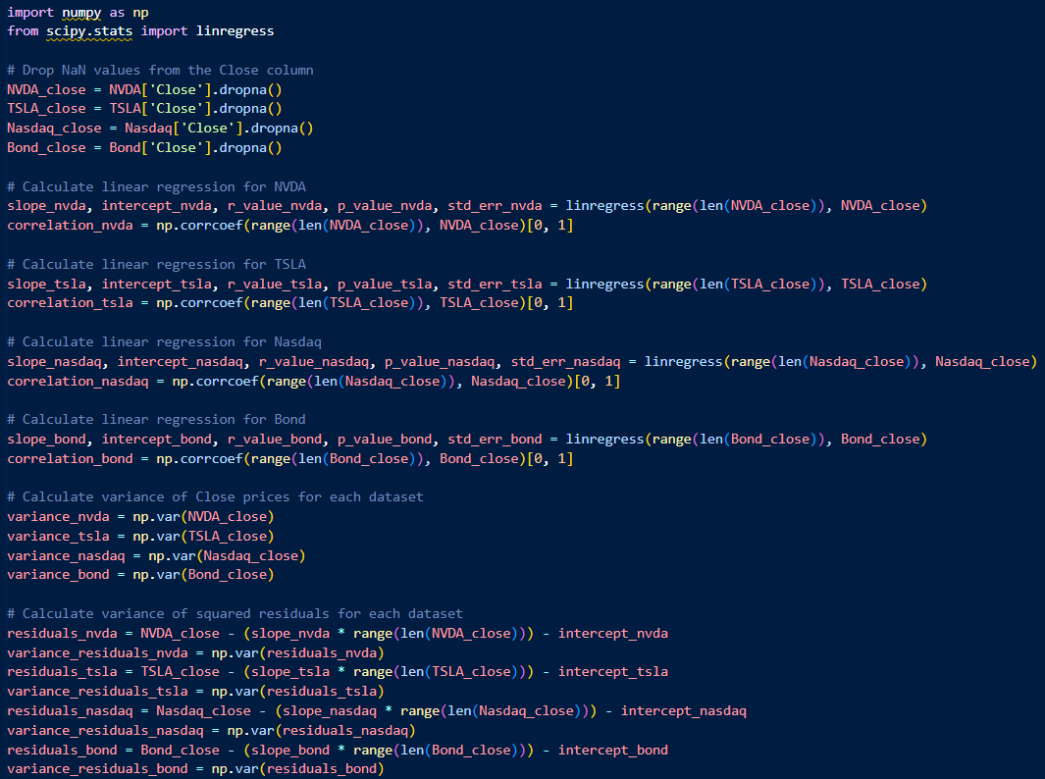

Slide 15
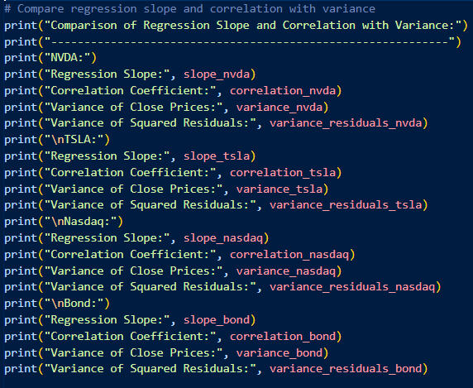

Slide 16
Scatter Plot Theory and Correlation between Investment Options
We expect that technology stocks would be highly positively correlated with a technology index; in other words, the correlation of technology stocks to technology indexes measures the "techiness" of supposedly tech stocks
Our scatter plots with linear regression and correlation coefficients are visual representations of this correlation relationship.
The correlation of stock price returns with 5 Yr. T-Bonds is another important comparison metric. Treasury bonds are long term loans made to the US government that pay a fixed rate of interest every six months for the life of the bond.
If investors can receive a risk-free Treasury Bond, they might hesitate to take on additional risk by purchasing a Corporate Bond. Therefore, we might expect to see negative correlation. For the time horizon we are considering, the effect of higher T-Bonds were offset by record high Federal stimulus.

Slide 17
Scatter Plots and Correlation Coefficients – Stocks vs Nasdaq and 5 year Treasury Bonds
Scatter Plot 1- Tesla vs Nasdaq - R value = 0.9
Scatter Plot 2 - NVDA vs Nasdaq - R value = 0.79
Scatter Plot 3 - Tesla vs 5 Year Treasury Bond - R Value= 0.41
Scatter Plot 4 -NVDA vs 5 Year Treasury Bond - R Value=0.61

Slide 18
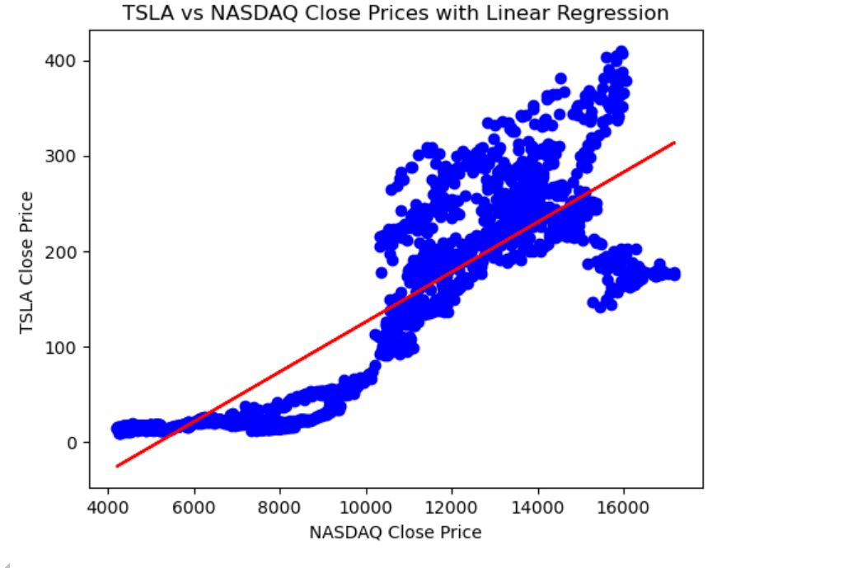
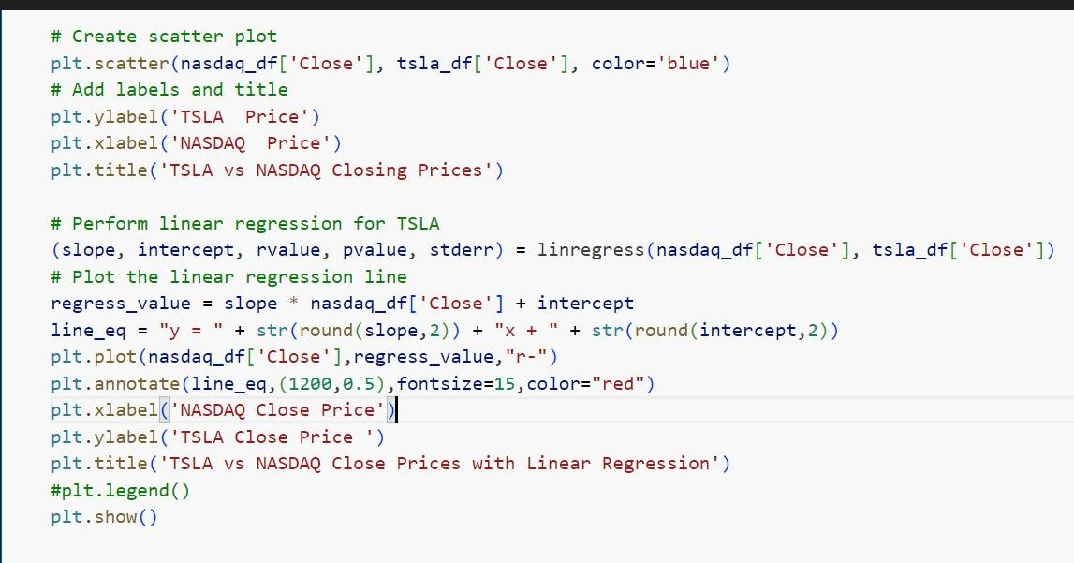
Scatter plot with linear regression and the correlation coefficients

Slide 19
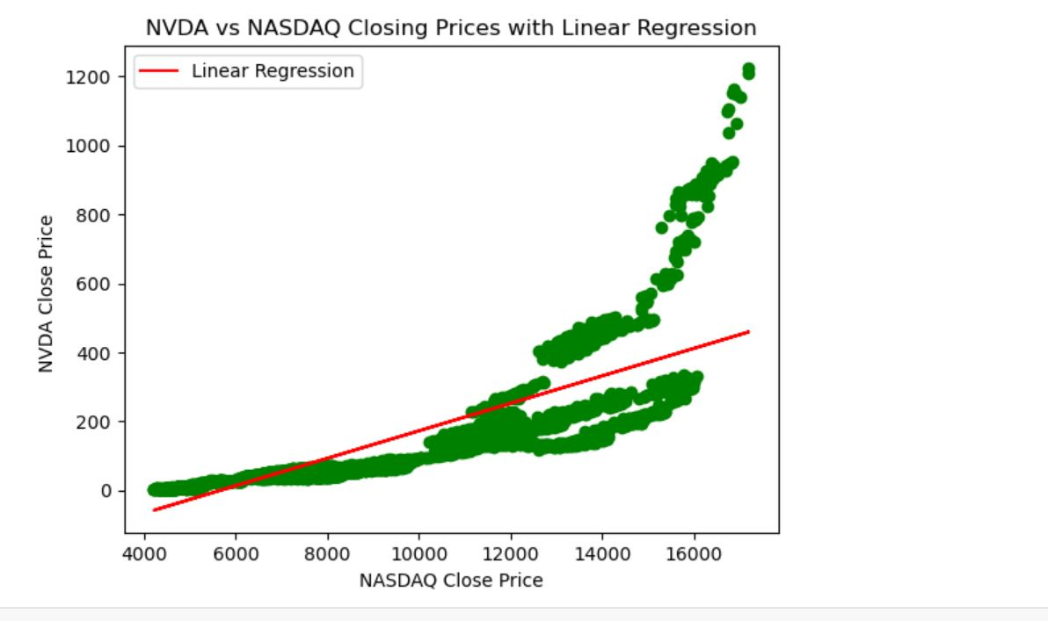
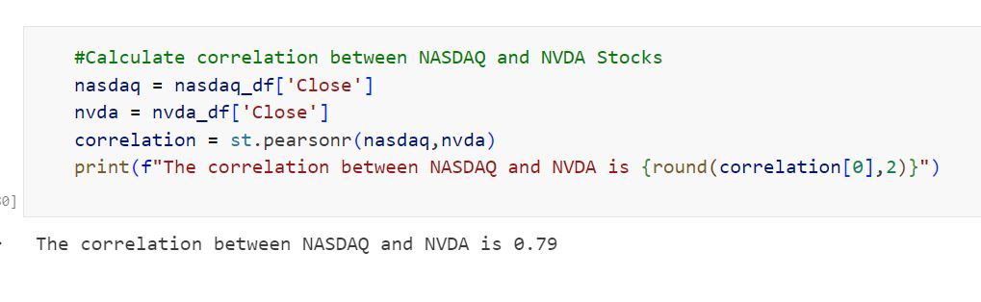
Scatter plot with linear regression and the correlation coefficients

Slide 20
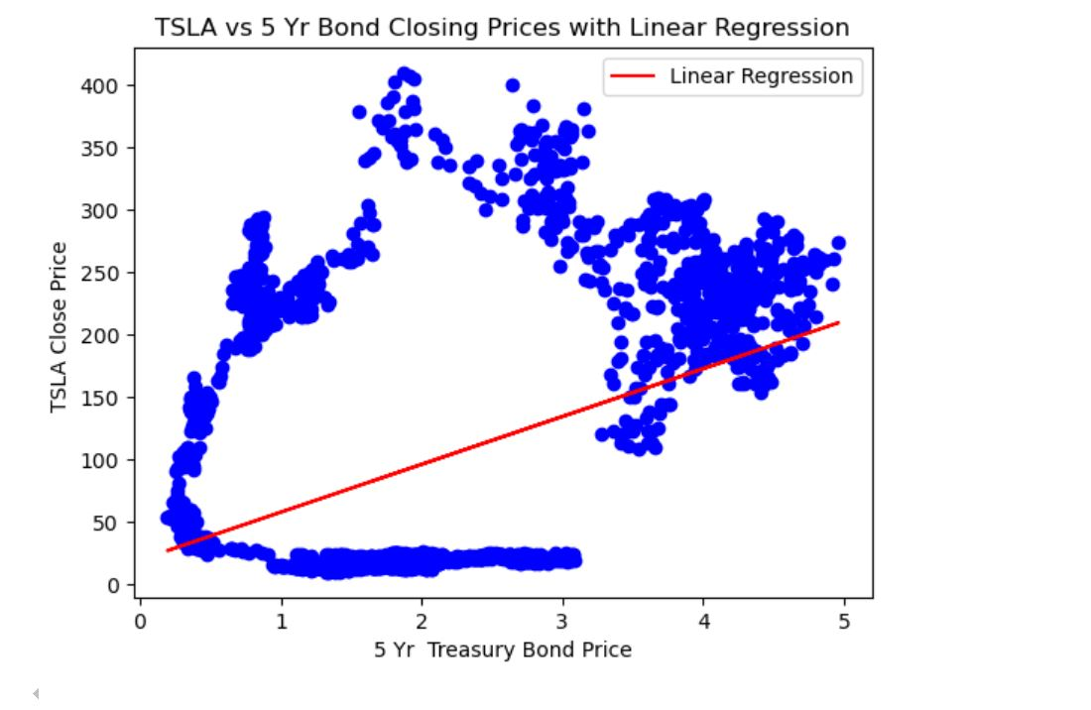
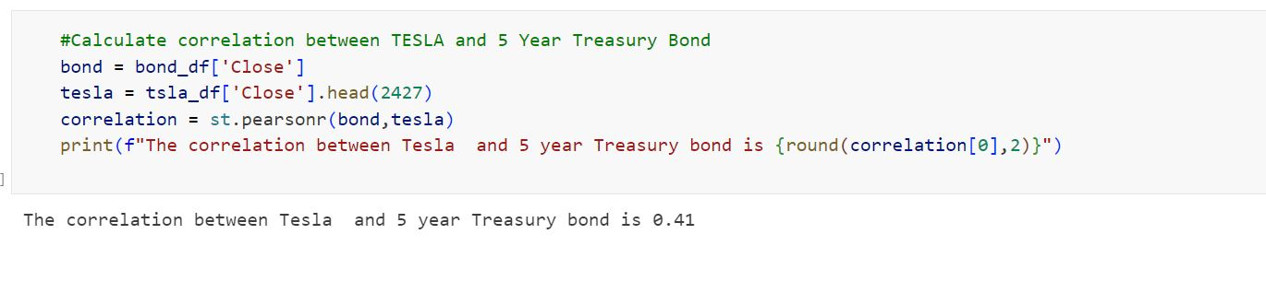
Scatter plot with linear regression and the correlation coefficients

Slide 21
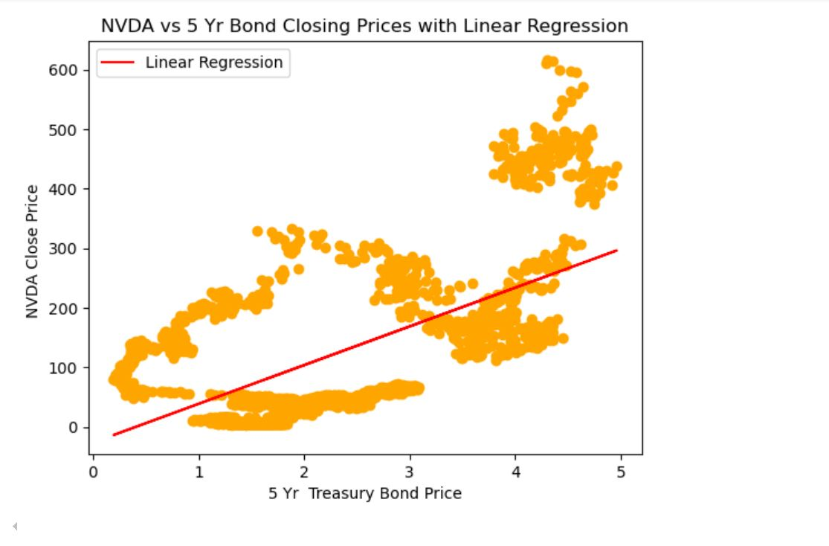
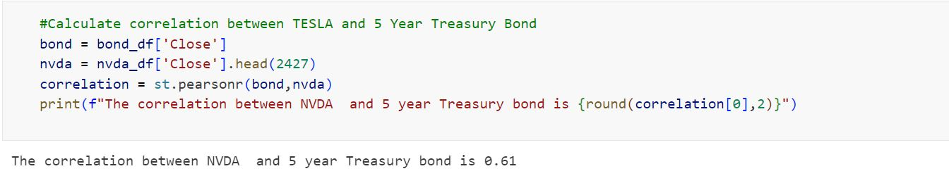
Scatter plot with linear regression and the correlation coefficients

Slide 22
Linear transformations of data are often performed for several reasons:
Normalization: Linear transformations can be used to normalize data, which is important for many statistical analyses. Normalization scales the data to have a mean of zero and a standard deviation of one, making it easier to compare variables with different scales and units.
Rescaling: Linear transformations can rescale data to a different range, such as mapping it from one interval to another. This can be useful for visualizing data or for ensuring that the data falls within a specific range required by a particular algorithm or model.
Standardization: Linear transformations can standardize data by centering it around a mean of zero. Standardization removes the mean from the data and scales it by the standard deviation, making it easier to interpret coefficients in regression models and ensuring that variables contribute equally to the analysis.
Dimensionality Reduction: Linear transformations can also be used for dimensionality reduction techniques like Principal Component Analysis (PCA) or Singular Value Decomposition (SVD). These methods transform the data into a lower-dimensional space while preserving the most important information, allowing for easier visualization or analysis of high-dimensional datasets.
Ease of Interpretation: Linear transformations can sometimes make data easier to interpret or analyze. For example, transforming non-linear relationships into linear ones can simplify regression analysis or other statistical techniques.
Overall, linear transformations are powerful tools in data analysis and can be used to preprocess data, improve interpretability, and enable various types of analysis and modeling. However, it's essential to consider the context and purpose of the analysis when deciding whether and how to apply linear transformations to your data.

Slide 23
Why use logarithms?
Taking the logarithm of stock prices helps eliminate or reduce skewed data, making the analysis more robust. Different companies have varying stock prices, and to compare them effectively, their values need to be normalized. Log transformation achieves this by stabilizing variance and making the relationships between different stocks more linear. This approach ensures that percentage changes are compared rather than absolute price changes, which is especially useful when dealing with stocks that have significantly different closing prices.

Slide 24
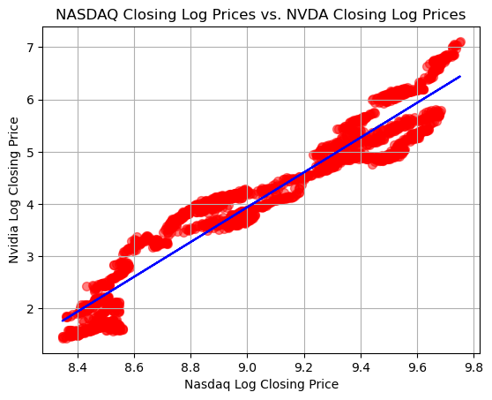
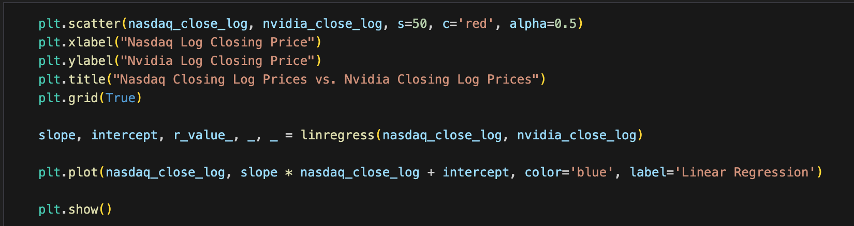
Scatter plot that evaluates the correlation between NASDAQ and NVDA
The Correlation Coefficient between NASDAQ and NVDA is 0.96

Slide 25
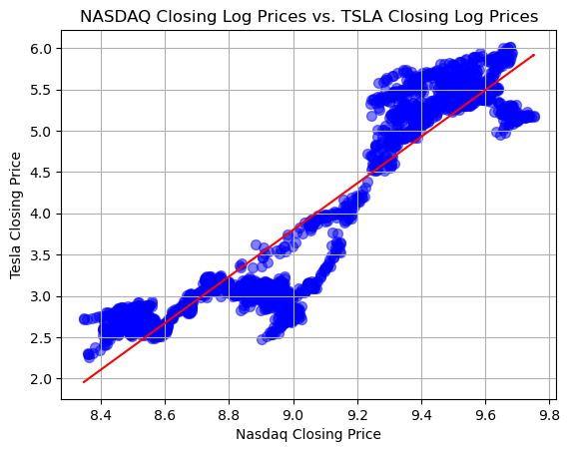
Scatter plot that evaluates the relationship between NASDAQ and TSLA
The Correlation Coefficient between NASDAQ and NVDA is 0.93

Slide 26
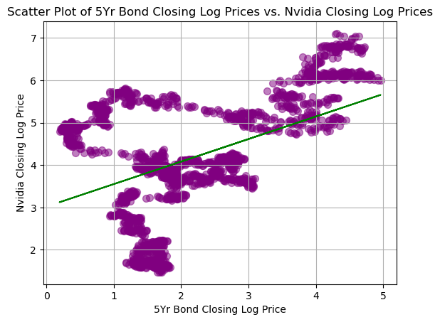
Scatter plot that evaluates the relationship between 5-Year Treasury bond and NVDA
The Correlation Coefficient between 5-Year Treasure Bond and NVDA is 0.44

Slide 27
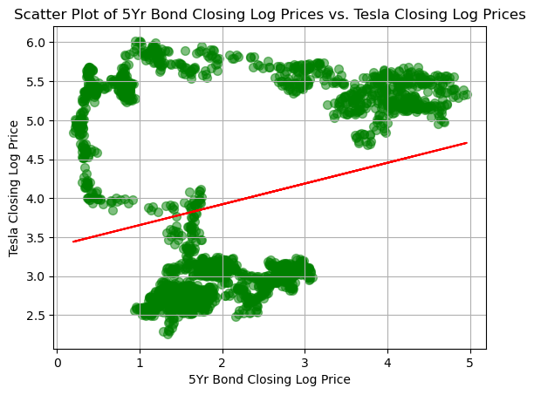
Scatter plot that evaluates the correlation between 5-Year Treasury bond and TSLA
The Correlation Coefficient between 5Yr Bond and TSLA is 0.25

Slide 28
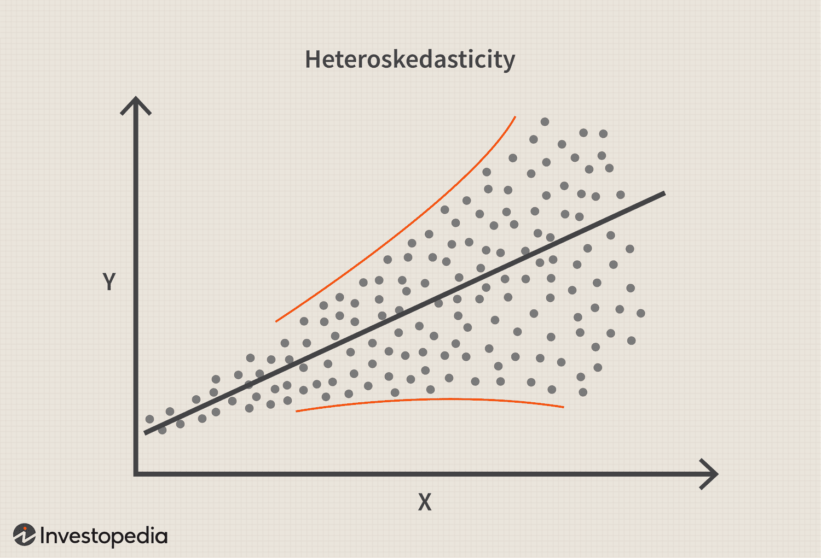

Slide 29
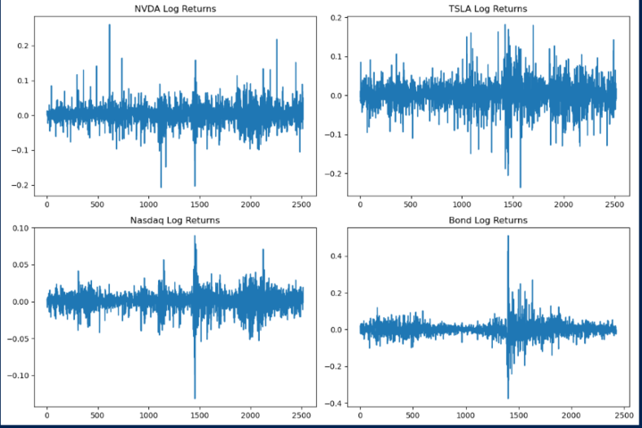

Slide 30
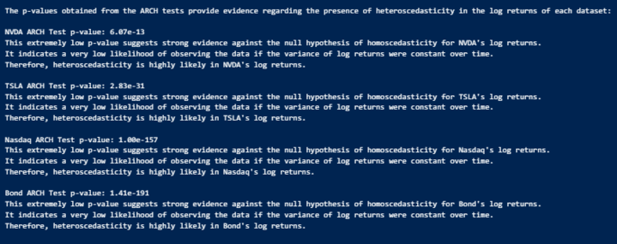

Slide 31
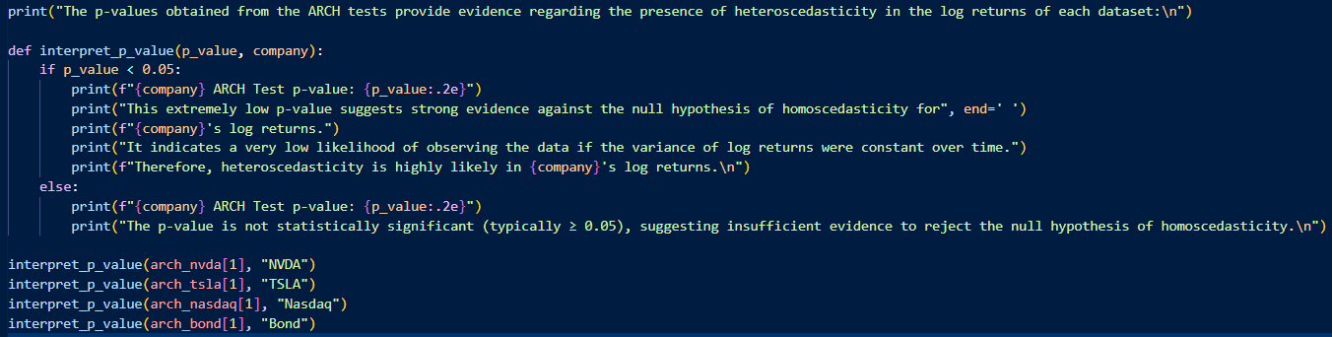

Slide 32
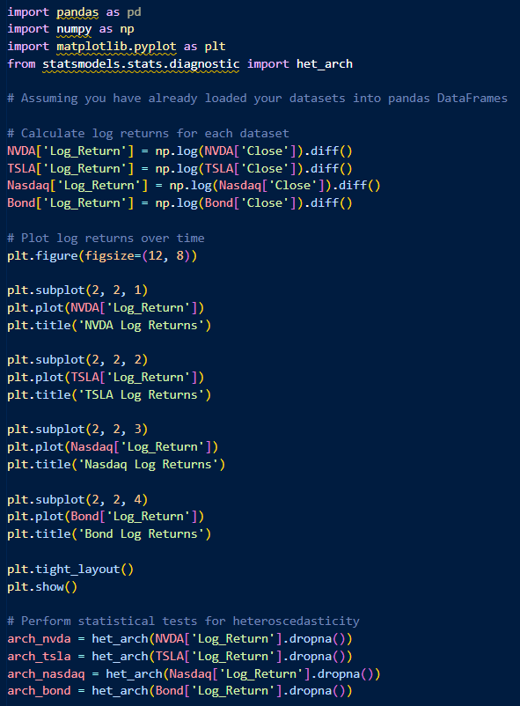

Slide 33
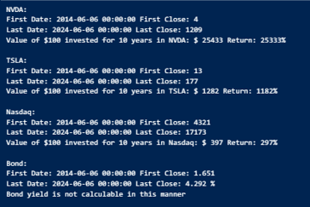
Investment Performance Summary Investors may wish to use the historical returns of various assets as a basis for making future investments decisions. We explore four possible investment choices: two technology companies (Tesla and Nvidia), Nasdaq and 5yr. Treasury Bonds. If an investor were to invest $100 in these 10 (or 30) years ago, what would that $100 be worth today?

Slide 34
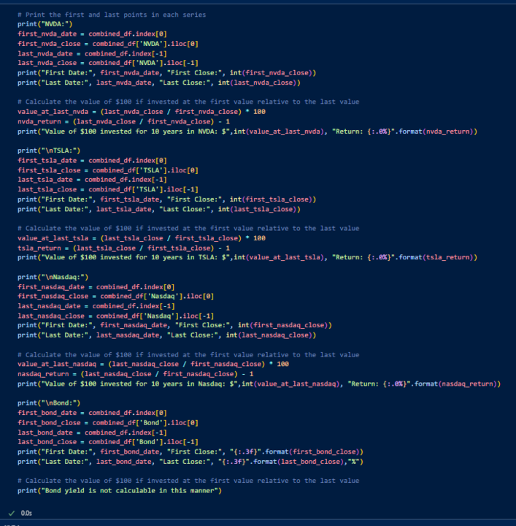

Slide 35
Return on Investment of $100 invested over a ten year period
Investment amount = $100
Nvidia = Return on Investment on 06/06/2024 if invested on 06/06/2014
= $ 25,433.00
Tesla = Return on Investment on 06/06/2024 if invested in 06/06/2014
= $ 4,088.00
Nasdaq = Return on Investment on 06/06/2024 if invested in 06/06/2014
= $ 397.00
*10 Year Treasury Bond = 2.59% Return on Investment today – low value compared to stocks but little to no risk

